Slide 1
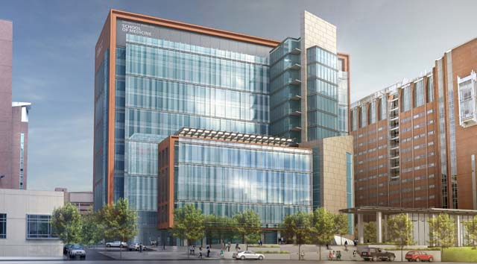
UNIVERSITY OF MARYLAND – BALTIMORE HEALTH SCIENCES FACILITY III
SENIOR THESIS PRESENTATION
KENNETH M. MOORE LIGHTING / ELECTRICAL THESIS ADVISOR │ SHAWN GOOD

Slide 2
PROJECT OVERVIEW
PROJECT OVERVIEW PROJECT LOCATION DESIGN CONCEPT ELEVATOR LOBBY NANOMEDICINE WORKSTATION MEETING ROOM REPORT BREADTHS ELECTRICAL DEPTH REPORT SUMMARY
BACKGROUND

Slide 3
SOUTH FAÇADE
HIGHLY ADVANCED RESEARCH FACILITY
HOUSES RESEARCH GROUPS FOR SCHOOLS OF MEDICINE, PHARMACY, AND DENTISTRY
ARCHITECT HELLMUTH, OBATA, KASSABAUM (HOK)
CONSTRUCTION MANAGER BARTON MALOW COMPANY
OWNED BY UMB OFFICE OF FACILITIES MANAGEMENT
“The Health Sciences Facility III further strengthens our footprint in west Baltimore and, as a result, our economic impact on the city and the state. We’re privileged to be able to help revitalize our critically important Baltimore neighborhoods and the state of Maryland as a whole, and at the same time, enable biomedical research and education that has the potential to save lives.”
Jay A. Perman, MD
President, University of Maryland
PROJECT OVERVIEW PROJECT LOCATION DESIGN CONCEPT ELEVATOR LOBBY NANOMEDICINE WORKSTATION MEETING ROOM REPORT BREADTHS ELECTRICAL DEPTH REPORT SUMMARY
BACKGROUND

Slide 4
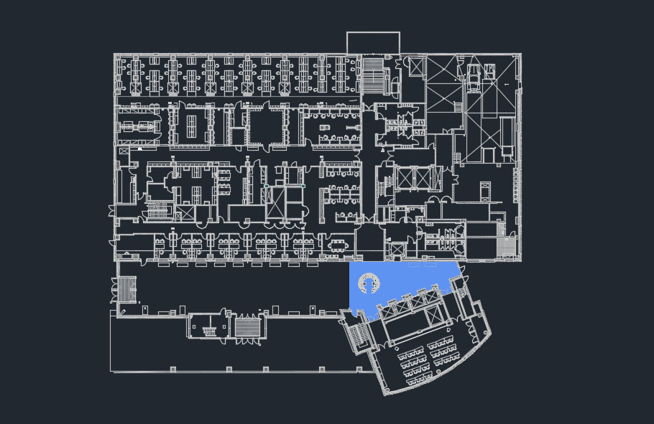
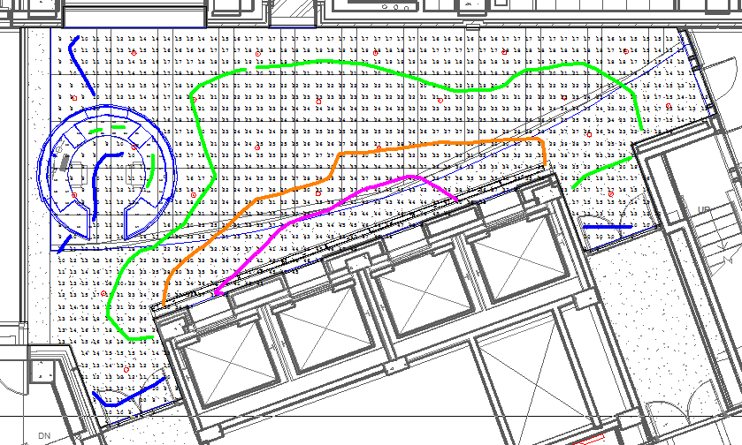
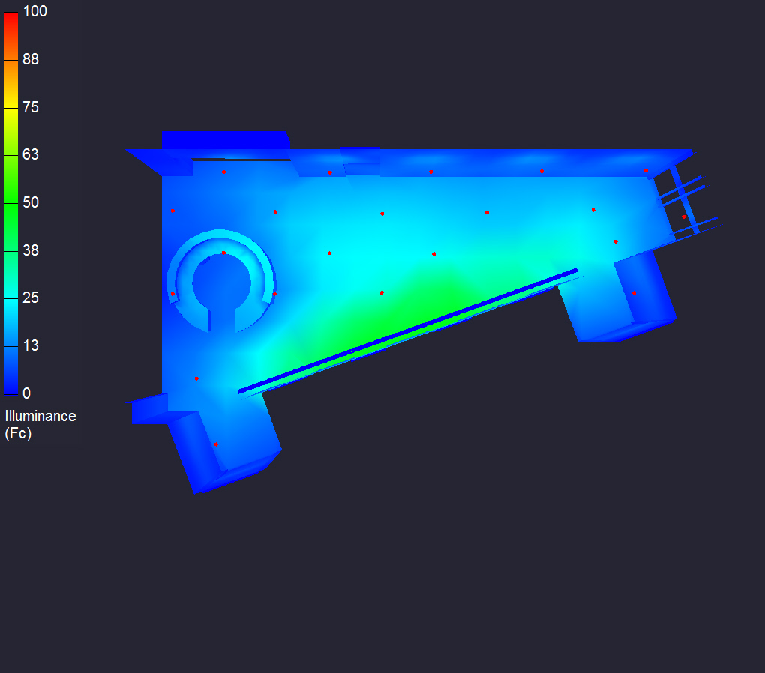
CALCULATION SUMMARY
10
20
30
40
PROJECT OVERVIEW PROJECT LOCATION DESIGN CONCEPT ELEVATOR LOBBY NANOMEDICINE WORKSTATION MEETING ROOM REPORT BREADTHS ELECTRICAL DEPTH REPORT SUMMARY

Slide 5
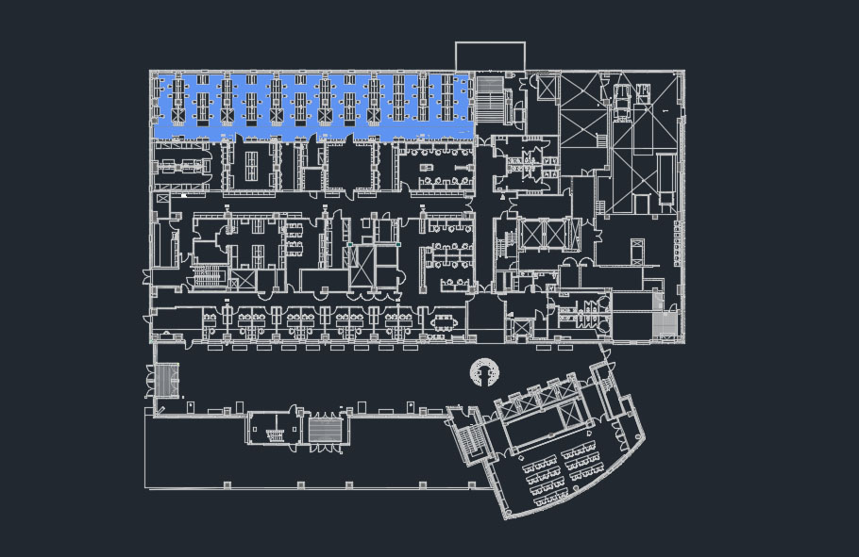
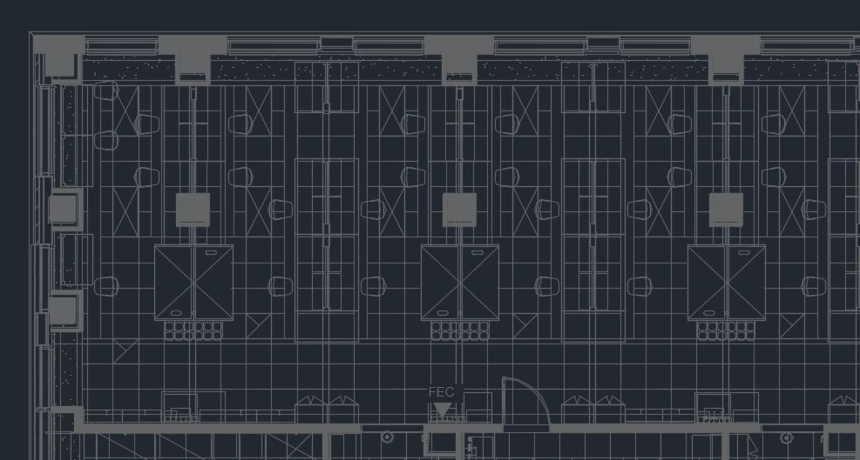
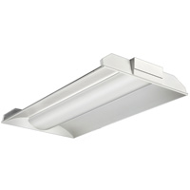
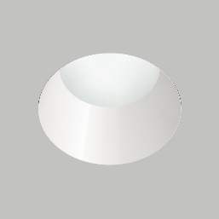
LUMINAIRE SUMMARY
RECESSED 1 x 4 LINEAR FLUORESCENT DOWNLIGHT
RECESSED LED DOWNLIGHT
PROJECT OVERVIEW PROJECT LOCATION DESIGN CONCEPT ELEVATOR LOBBY NANOMEDICINE WORKSTATION MEETING ROOM REPORT BREADTHS ELECTRICAL DEPTH REPORT SUMMARY

Slide 6
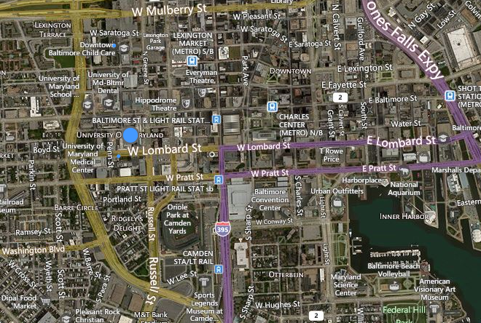
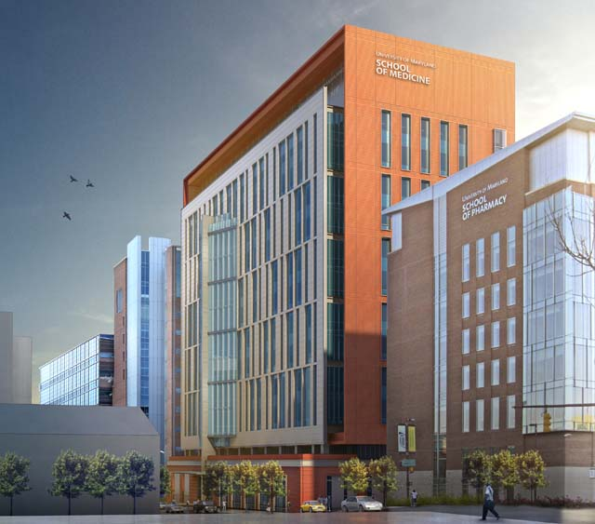
ELEVATOR LOBBY
WORKSTATION
MEETING ROOM
Lighting Criterion | Recommended Value | Achieved Value | Criteria Met
LPD Area Summary | < 0.9 W/ft² | 0.843 W/ft² | Yes
Average Target Illuminance | ≥ 10 fc | 22.3 fc | Yes
Desk Surface Illuminance | 15 fc | 16.8 fc | Yes
Lighting Criterion | Recommended Value | Achieved Value | Criteria Met
LPD Area Summary | < 1.59 W/ft² | 0.973 W/ft² | Yes
Average Target Illuminance | ≥ 50 fc | 62.8 fc | Yes
Lighting Criterion | Recommended Value | Achieved Value | Criteria Met
LPD Area Summary | < 1.23 W/ft² | 0.685 W/ft² | Yes
Average Target Illuminance | ≥ 30 fc | 34.9 fc | Yes
PROJECT OVERVIEW PROJECT LOCATION DESIGN CONCEPT ELEVATOR LOBBY NANOMEDICINE WORKSTATION MEETING ROOM REPORT BREADTHS ELECTRICAL DEPTH REPORT SUMMARY
BACKGROUND

